Slide 1
OTC Credit Management

Slide 2
SD Credit Management
Credit Management Benefits
Integration with SD and FI
Centralized Credit Management
Credit Control Area
Different Type of Credit Checks
Credit Group for Customers
Customer Credit Master
Manage Business Partner
Manage Credit Decisions – SD Documents
Manage Customer Line Items
List Billing Documents
Lesson Objectives

Slide 3
Credit Management

Slide 4
Introduction to Credit Management Concept
A time period can be defined in SAP within which a customer is supposed to pay his accounts. This time period is defined via the "payment term" defined in the Customer Master Record.
SAP has developed a complex credit management solution that enables the maintenance of set credit limits per Customer as well as the system responses in case of credit limit is exceeded
Customer credit limits are maintained individually in Credit Control Area wise by Finance Management

Slide 5

Credit Management Benefits
Credit Management enables you to minimize the credit risk by specifying a specific credit limit for the customers
A credit limit check can be carried out when sales documents are created or changed
Benefits of credit management:
Reduce risk of bad debt
Focus on reliable and profitable customers
Faster credit-worthiness check
Accelerate the process of checking a customer credit limit
Identify the overall credit risk of your company

Slide 6
Integration with SD and FI
Credit Management is a cross-functional activity between SD and FI
SD
FI
C
R
E
D
I
T

Slide 7
Integration with SD and FI
Credit Management
SD, FI
Cust: Health Express
Risk: Medium
Credit Limit: $10,000
Ttl. Commit: $6,000
Order: 5923
Order Amount: $5,000
Credit Limit Exceeded
Block order
E-mail to credit rep. (opt.)
Blocked document list
or E-mail (opt.)
Review situation
Release order
Pick, pack & ship order
Bill Customer
Credit control (blocks) can be applied at order entry, delivery creation or goods issue.

Slide 8
Centralized Credit Management
CREDIT CONTROL AREA 1
Company Code 1
Company Code 2
Sales Organization 1
Sales Organization 2
If your credit management is centralized, you can combine your company codes in one credit control area. Credit management then regards the customer as valid for all company codes. In the following graphic, the customer has a business relationship to two company codes that are combined in one credit control area:

Slide 9
Decentralized Credit Management
Credit Control Area 1
Credit Control Area 2
Company Code 1
Company Code 2
Sales Organization 1
Sales Organization 2
If your credit policy requires decentralized credit management, you can define credit data for your customer for each company code. In the graphic above, the customer has a business relationship with two company codes:
You define a currency for each credit control area. The relationship between credit control area, company code, sales organization and currency is illustrated in the above graphic:

Slide 10

Credit Exposure Covers
Open Order Value: The value of all sales order items which have not yet delivered
Open Delivery Value: The value of all delivery items which are not yet billed
Open Billing Value: The value of all billing items which are not yet transferred to Accounting
Open Items: The value of billed items which are transferred to accounting (receivables)

Slide 11
Credit Control Area
The Credit Control Area is an Organizational Unit that specifies and check a credit limit for customers
A credit control area can include one or more company codes. It is not possible to assign to assign a company code to more than one credit control area. Within credit control area the credit limits must be specified in the same currency
Credit and Risk management takes place in the credit control area
For centralized credit management, you can define one credit control area for all your company codes
For decentralized credit management, you can define credit control area for each company code
In the credit control area configuration important fields are currency, update group, risk category and credit limit

Slide 12
Credit Control Area
CREDIT CONTROL AREA
Company Code 1
Company Code 2
Company Code 3
Sales Organization 1
Sales Organization 3
Sales Organization 3
Sales Organization 2
SAP Definition: Credit Control Area is an Organizational Unit that represents the area where Customer Credit is awarded and monitored. This Organizational Unit either be a single or several Company Codes, if Credit Control is performed across several Company Codes.

Slide 13
Sources of Information in Credit Management
Customer master record
Oldest open item
Account analysis
Last payment
Line items
Customer Master Record
Credit Control Area
Credit Limit
FI Information system
Credit overview
SD Information system
Credit master sheet
Early warning list

Slide 14
Credit Control Area
The Credit Control Area is an Organizational Unit that specifies and check a credit limit for customers
A credit control area can include one or more company codes. It is not possible to assign to assign a company code to more than one credit control area. Within credit control area the credit limits must be specified in the same currency
Credit and Risk management takes place in the credit control area
For centralized credit management, you can define one credit control area for all your company codes
For decentralized credit management, you can define credit control area for each company code
In the credit control area configuration important fields are currency, update group, risk category and credit limit

Slide 15
Different Type of Credit Checks
CREDIT CHECK
Simple credit check
SIMPLE CREDIT CHECK
AUTOMATIC CREDIT CHECK
STATIC CREDIT CHECK
DYNAMIC CREDIT CHECK

Slide 16
Simple Credit Check
A simple credit checks can be carried out when sales documents are created and changed
The check is carried out within one Credit control area
When changing a document, the check is repeated if changes regarding quantity or value are made
A sales document belongs to one credit control area depending on the allocation of the sales organization to a company code. The SAP system checks the credit limit which was granted to the customer in this credit control area
During the check, the SAP system totals the receivables, the open item from special G/L transactions and the net value of the sales order for every item of a sales document. The total is compared with the credit limit. If the limit is exceeded, the system responds in the way defined by you in the configuration menu

Slide 17
Simple Credit Check
A credit check occurs in three places
Sales Order
Delivery
Goods Issue
The response can be either
Error
Warning
Delivery Block

Slide 18
Automatic Credit Check
Credit checks can be configured differently for different document types and different customer groups
This one is required because all customers are not the same, some can be trusted and some cannot be trusted again different credit policies should be applicable
In simple credit check the checking is similar for all customers and documents in the credit control area
In automatic credit check, to create different credit controls with different combinations are created by the combination of credit control area + credit group + risk category
In automatic credit check there are two types credit checks available
Static Credit Limit check
Dynamic Credit Limit Check with Credit Horizon
Static Credit Limit check
Dynamic Credit Limit Check with Credit Horizon
You can define a credit check for any valid combination of the following data:
Credit control area
Risk category
Document credit group

Slide 19
Static vs. Dynamic Credit Check
Credit Limit
Open
Order
Open
Order
Open
Order
Open
Order
Open
Order
Open
Order
Dynamic Check
Open
Delivery Value
Open
Delivery Value
Receivables
Receivables
Static Check
Credit Horizon

Slide 20
Static Credit Limit Check
The customer's credit exposure may not exceed the established credit limit. The credit exposure is the total combined value of the following documents:
Open orders
Open deliveries
Open billing documents
Open items (accounts receivable)
The open order value is the value of the order items which have not yet been delivered
The open delivery value is the value of the delivery items which have not yet been invoiced
The open invoice value is the value of the billing document items which have
not yet been forwarded to accounting
The open items represent documents that have been forwarded to accounting but not yet settled by the customer

Slide 21
Static Credit Limit Check
Open Orders
Open Deliveries
Open Billing Documents
Open Items (Accounts Receivable)
The customer's credit exposure may not exceed the established credit limit. The credit exposure is the total combined value of open sales orders + open deliveries + open billing documents + open items

Slide 22
Dynamic Credit Limit Check with Credit Horizon
The customer's credit exposure is split into a static part; open items, open billing, and delivery values (see above), and a dynamic part, the open order value
The open order value includes all undelivered or only partially delivered orders
The value is calculated on the shipping date and stored in an information structure according to a time period that you specify (days, weeks, or months)
When you define the credit check, you can then specify a particular horizon date in the future (for example: 10 days or 2 months, depending on the periods you specify)
For the purposes of evaluating credit, you want the system to ignore all open orders that are due for delivery after the horizon date
The sum of the static and dynamic parts of the check may not exceed the credit limit

Slide 23
Dynamic Credit Limit Check with Credit Horizon
Open Orders
D
Y
N
A
M
I
C
C
R
E
D
I
T
C
H
E
C
K
Combined total value of open deliveries open billing documents open items open sales orders for a specified horizon
In dynamic credit check a particular horizon time range in the future is specified (for example: 10 days or 2 months, depending on the periods you specify). All open orders that are due for delivery after the horizon date are ignored
Open Deliveries
Open Billing Documents
Open Items (Accounts Receivable)
Credit Horizon

Slide 24
Credit Group
SAP Definition
The credit group groups together different business transactions which should be dealt with in the same manner with regard to the credit check
You enter the credit groups when you configure the sales document types for credit management and define the automatic credit check
Default settings
The following credit groups are contained in the standard SAP System
01 - Credit group for sales order
02 - Credit group for delivery
03 - Credit group for goods issue

Slide 25
Credit Limits for Groups of Customers
Customers can be grouped together into customer groups on the basis of criteria (for example, by country). This customer group can be used as a basis for processing or evaluating the accounts within it.
Transaction Code: FD 32

Slide 26
Customer Credit Master
We can assign various credit settings in relation to Customer Master Record here is the Customer Credit Master is divided into five views
Overview: The credit settings in relation to the Customer including is
Credit Limit
Credit Exposure
% Credit Limit Used
Payment Data
Risk Category
Address: As in the customer master record
Central Data: Shows the total credit limit the customer can receive across all credit control areas as well as the maximum limit the customer can receive in one credit control area
Current credit limit assigned
Maximum individual credit limit
Last information
Maximum individual credit limit
Total amount, individual limit, currency

Slide 27
Customer Credit Master
Status: Shows the customer's actual individual details in a particular credit control area
Credit Limit
Credit Exposure
% Credit Limit Used
Risk Category
Whether the customer is blocked due to credit or not
Payment History: Payments made by the customer in a particular credit control area where a company code assigned

Slide 28
OTC Credit Management
Fiori Apps
Manage Business Partner
Manage Credit Decisions
Manage Customer Line Items
List Billing documents

Slide 29
SD Basic Functions-Concept
Manage Business Partner

Slide 30
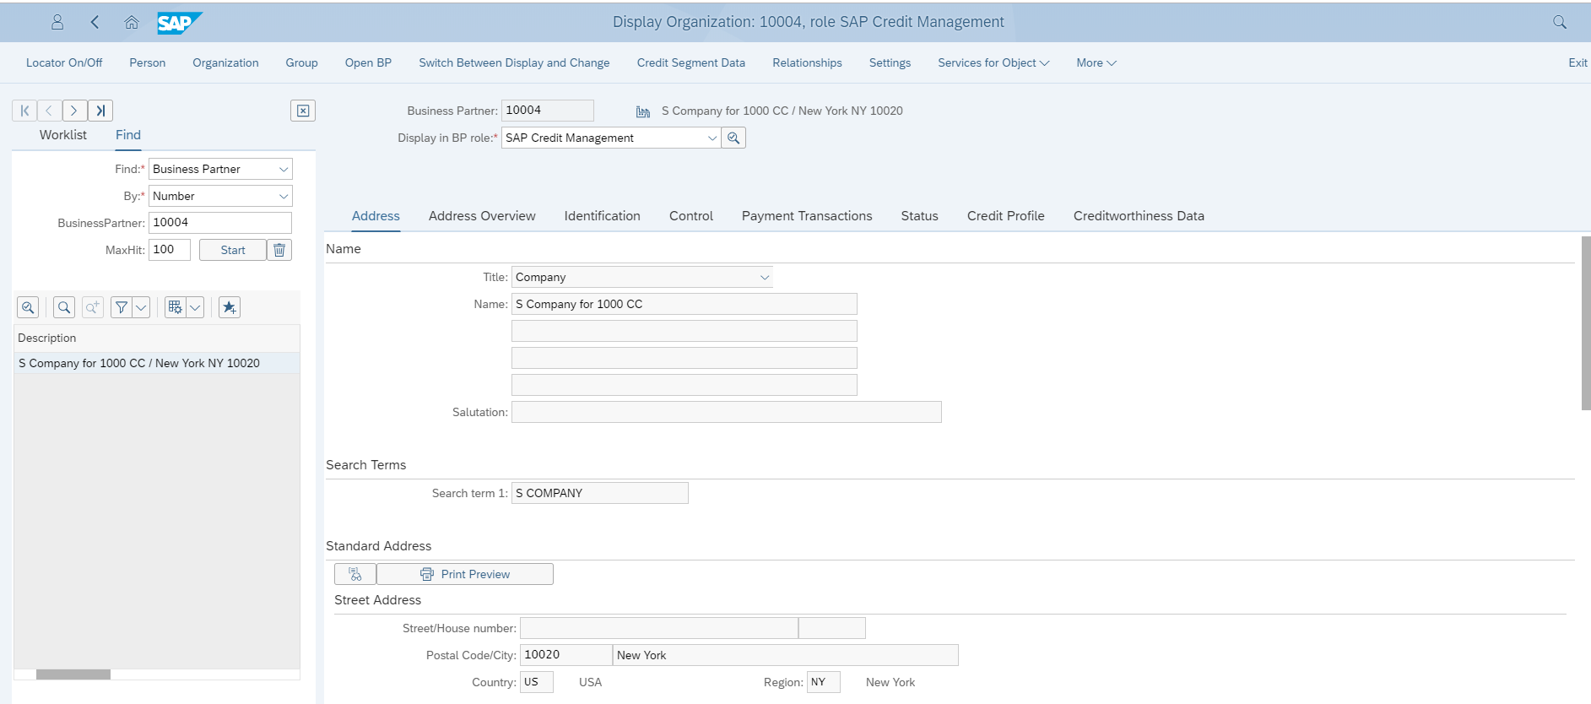
Manage Business Partner - Credit Profile
1. Select BP role from DDL
4. Select Credit Worthiness data and enter all information
3. Select Credit Profile and Enter Credit Details
2. Select Address Tab and Enter Address Details

Slide 31
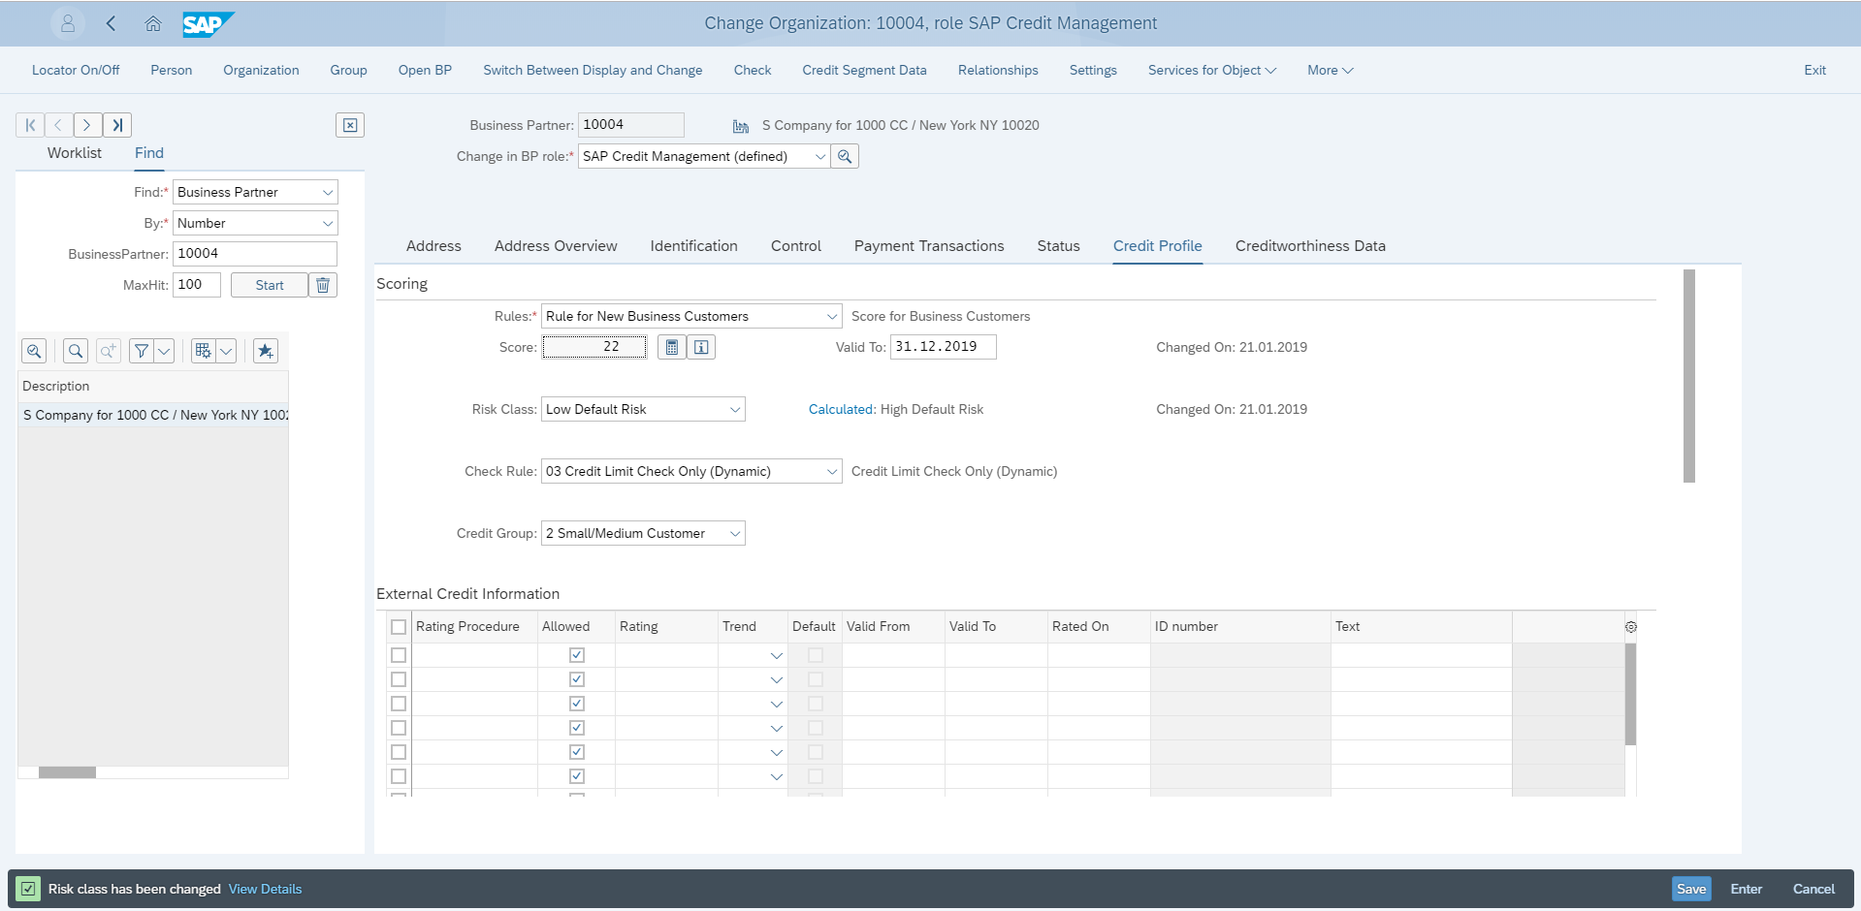
Manage Business Partner - Credit Profile
5. Select BP Role
6. Select Credit Profile Tab
7. Select Credit Profile Tab
8. Select Credit Profile Tab
9. Change Message Reflected
10. Click “Save” Button
11. Successfully Change information Saved

Slide 32
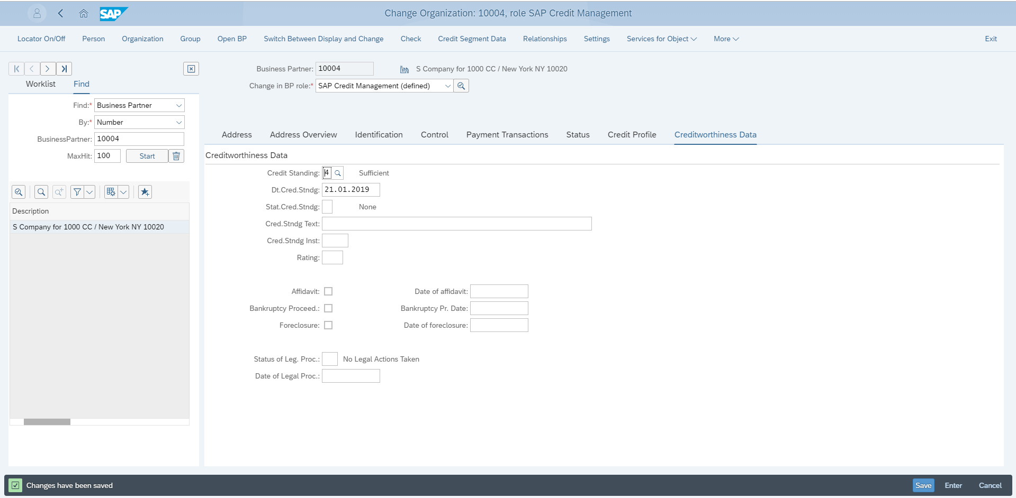
Manage Business Partner - Credit Profile
13. Select Credit Segment Data TAB
12. Select Creditworthiness Data Tab
14. Select Credit Standing
15. Click ”Save” Button
16. Successfully Change information Saved

Slide 33
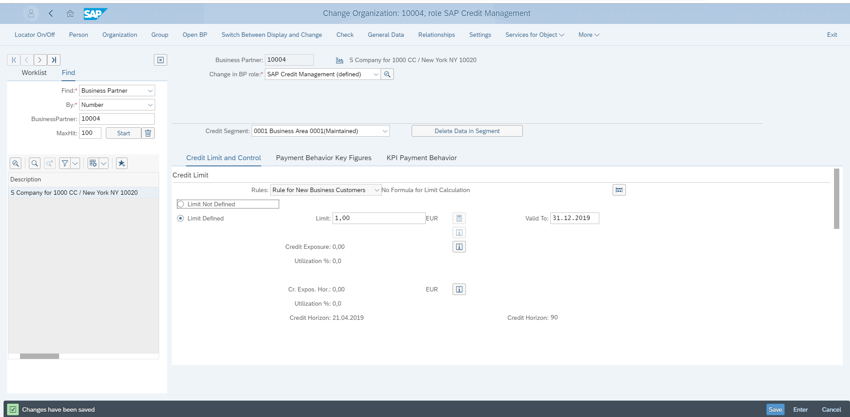
Manage Business Partner - Credit Profile
17. Select Credit Limit and Control Tab
18. Select Limit Defined Radio Button
19. Specify Limit
21. Successfully Change information Saved
20. Click “save “Button

Slide 34
SD Basic Functions-Concept
Manage Credit Decisions – SD Documents

Slide 35
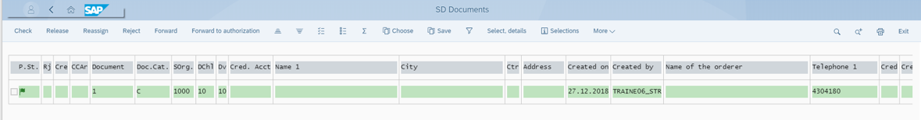
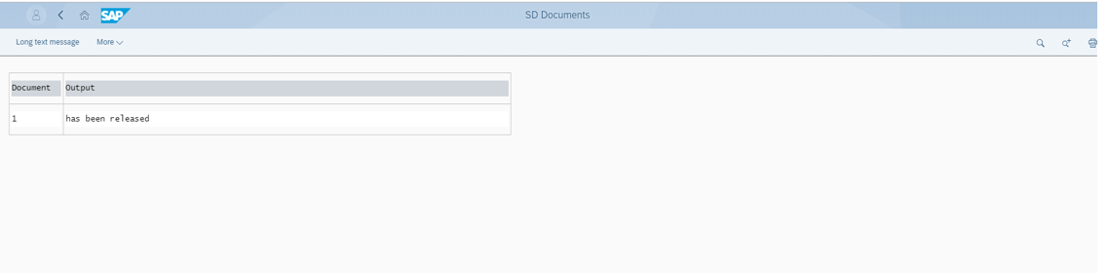
Manage Credit Decisions - SD Documents
6.Select “Check” Box
7.Click”Save Button
8.Sucessfully Document Released

Slide 36
SD Basic Functions-Concept
Manage Customer Line Items

Slide 37
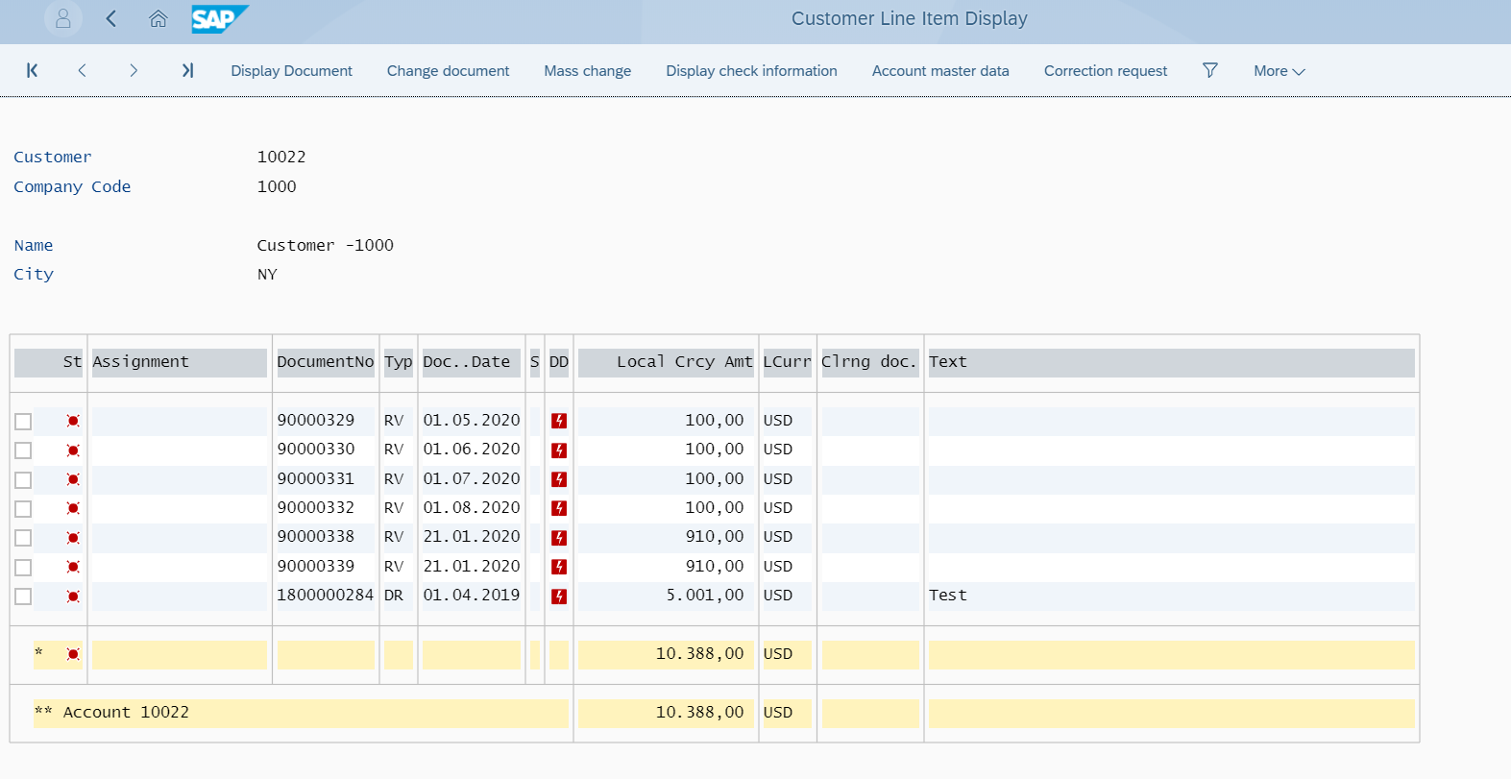
Manage Customer Line Items

Slide 38
SD Basic Functions-Concept
List Billing Documents

Slide 39
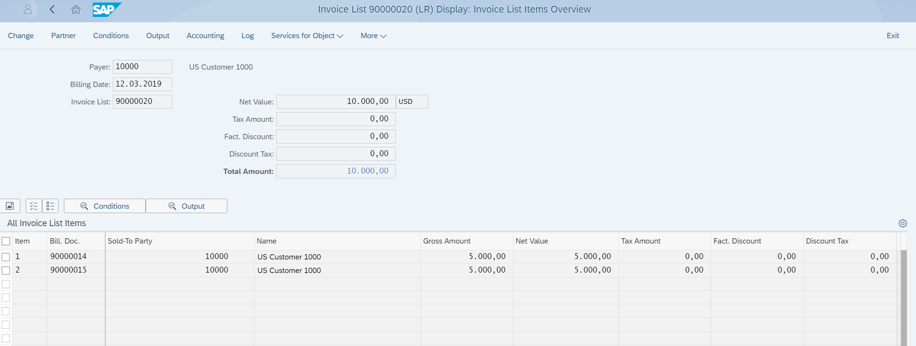
List Billing Documents

